Slide 1
INFORMATION SESSION
FOR NEW MEMBERS

Slide 2
INTRODUCING THE PMO AND PMAA

Slide 3
Welcome to the Port Macquarie Astronomical Association (PMAA), the governing body of the Port Macquarie Observatory (PMO). PMAA is a not-for-profit organization.

Slide 4
Legal Name:
Port Macquarie Astronomical Association Incorporated,
T/A Port Macquarie Observatory.
ABN: 45697909376
Details:
Website: pmobservatory.org.au
Address: Rotary Park, 1 A Stewart Street
P.O Box 1453, Port Macquarie 2444
Date established: 26 August 1962
The PMAA operates as an incorporated association. It is a member-based, volunteer-driven, not for profit organization with an elected committee responsible for its administration and activities.

Slide 5

The key objectives of the Association are:
(a) spark curiosity and develop an interest in astronomy and science through educational engagement.
(b) enrich the lives of the community and in particular the Association’s members through activities relating to astronomy and science
(c) raise, receive and administer funds for the purpose of furthering the objectives of the Association.

Slide 6
President: The current president is Chris Francis
Committee Members: The committee is composed of various volunteer members who are eligible to serve after becoming “Ordinary Members”
Patron: The Association’s patron is Professor Fred Watson AM, Australia’s first Astronomer-at-large.
Volunteers: The PMAA is run by its active members who volunteer their time for various activities, including open nights, administration, fundraising and maintenance.

Slide 7
A BRIEF HISTORY OF PMAA

Slide 8
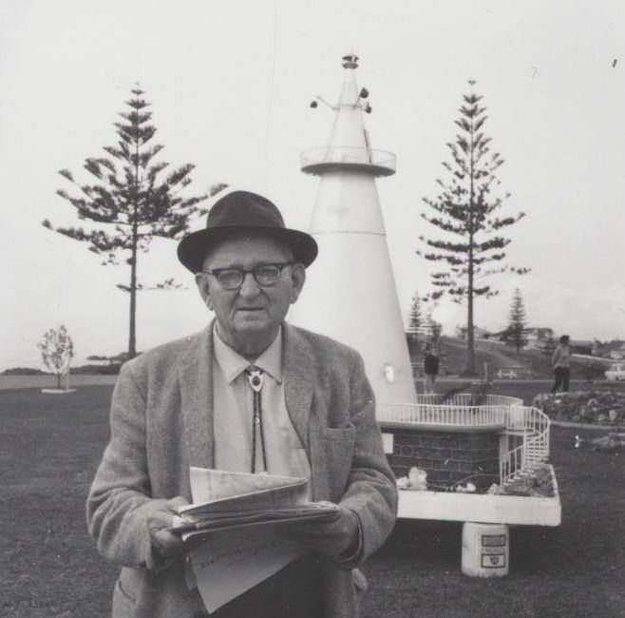
PMAA ORIGINS
Constructed in 1961/62 by the local Rotary Club following architect Albert York's designs, the Port Macquarie Observatory was originally built to house a donated 5-inch telescope. Officially inaugurated in 1965, it has since served as the headquarters for the Port Macquarie Astronomical Association.

Slide 9
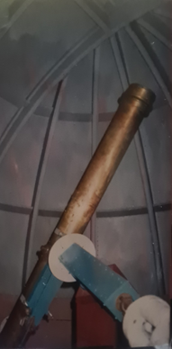
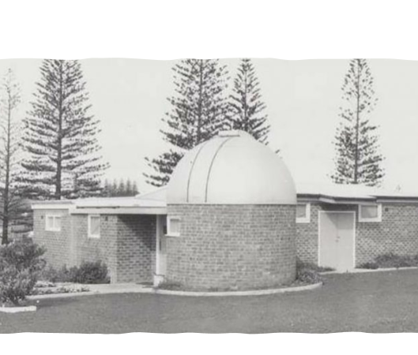
PMAA ORIGINS
Foundation: The project was spearheaded by Albert York, a local retired master builder, after the local Rotary club became interested in his vision for an observatory
Telescope: The Observatory was designed to house a 5-inch telescope originally gifted by a local publican for viewing ships at sea.
Location: It is built in Rotary Park, near Town Beach and was officially opened in 1965.
Management: It has been managed by the volunteer – based Port Macquarie Astronomical Association.

Slide 10
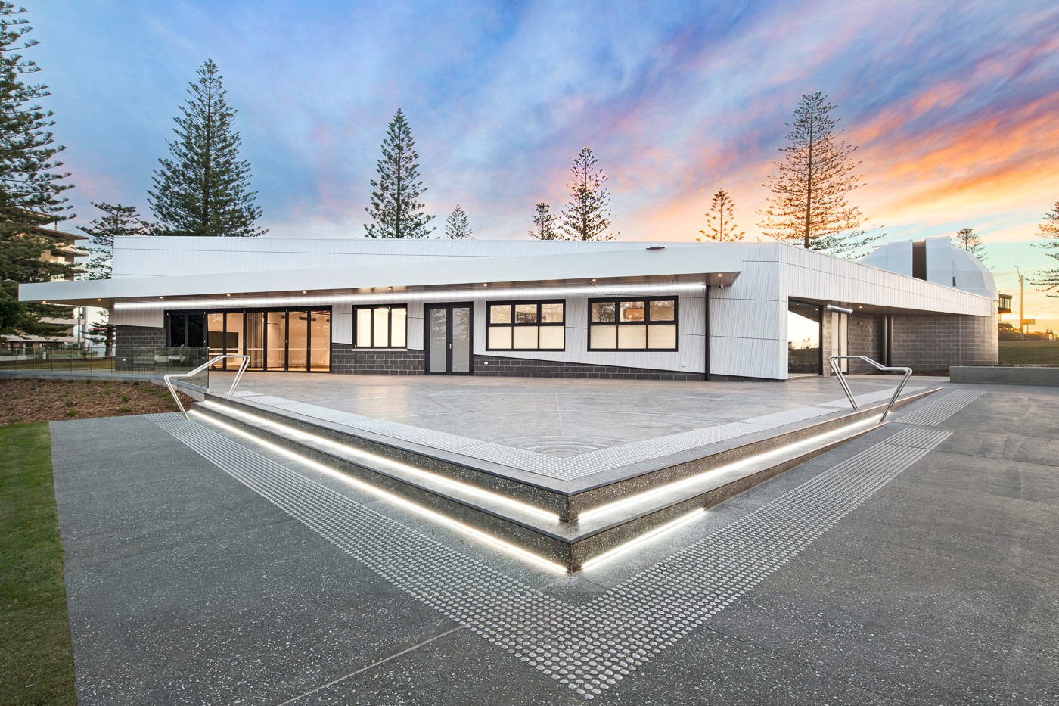
THE PRESENT
MAJOR UPGRADE: The historic 1961 observatory has been cleared to make way for a bold, next-generation Astronomy and Science Centre that transforms the entire site.
NEW FACILITIES: Step inside a powerhouse of discovery – featuring a striking 6.9m dome, a cutting edge 14inch telescope, an inspiring auditorium, versatile meeting rooms and dynamic science exhibition spaces.
FUNDING: Backed by a $5.7 Million investment from the Australian and NSW Governments through the Bushfire Local Economic Recovery Fund, this upgrade is a major boost for the region.
PURPOSE: Designed to energise the visitor economy and ignite community curiosity, the centre will deliver a vibrant program of events, experiences and learning opportunities for members and the public.

Slide 11

Membership of the PMAA offers:
Access to fellow like minded community, education and resources, including group observing sessions (star parties), expert guidance, telescope education programs, workshops, and access to dark sky sites, fostering learning and camaraderie among stargazers of all levels, from beginners to advanced amateurs.
Access to experienced astronomers who can help you learn more about the night sky and how to observe it.

Slide 12
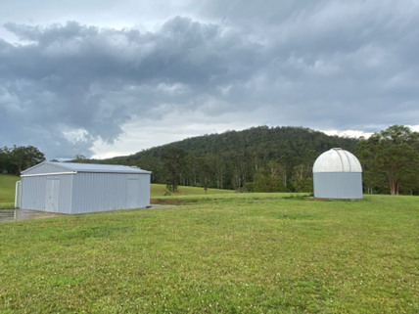
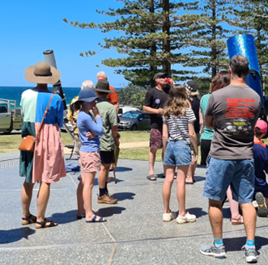
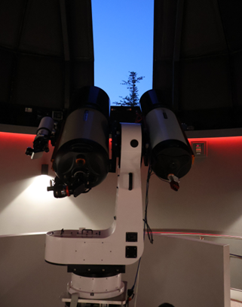
WHAT ARE THE MEMBERS’ ACTIVITIES AT PMAA?
SIDEWALK ASTRONOMY: Join us for a free, once –a-month Saturday spectacle at the Observatory! Catch breathtaking views of the sun through our specialised solar telescope- an unforgettable experience for all ages.
OPEN NIGHTS: As a member, you’re welcome to drop in any Wednesday, Friday or Sunday – completely free – whenever the stars call you.
TRAINING NIGHTS: Curious about astronomy? Want to get hands-on with telescopes and learn the differences between them? Our expert members are ready to share their knowledge and ignite your passion.
THE MORIPO DARK SKY SITE: Exciting things are happening! The historic dome from our original observatory is being restored at its new home in Moripo Park, Hyndmans Creek – exclusively for our members to enjoy the night sky at its darkest and best.

Slide 13

SOCIAL ACTIVITIES AT PMAA
MEMBER’S EVENING: A lively get-together held either at the Observatory or one of Port Macquarie’s great local venues. The perfect chance to relax, reconnect and swap stories with fellow astronomers.
CAFÉ ASTRONOMY: Our monthly social session with a twist – enjoy a guest presentation, great company, and stimulating conversation. Held at the Observatory from 2:00 to 3:00 pm
CHRISTMAS PARTY: The PMAA’s festive highlight! A fun, end- of -year celebration for all members as we wrap up another year of star-studded adventures.
OUTINGS TO OTHER ASTRONOMICAL CLUBS: From club visits to special events, PMAA loves a road trip! Past adventures include meeting with Tamworth Astronomical Club and an unforgettable journey to Siding Spring Observatory.

Slide 14
WHAT ARE THE MEMBERS’ RIGHTS AND OBLIGATIONS AT PMAA?
Constitution: Discover the guiding principles that shape and inspire our membership community! A copy of our dynamic constitution - detailing the standards and spirit that unite all members – is available upon request. You can also explore it anytime online at the following website: www.pmobservatory.org.au

Slide 15
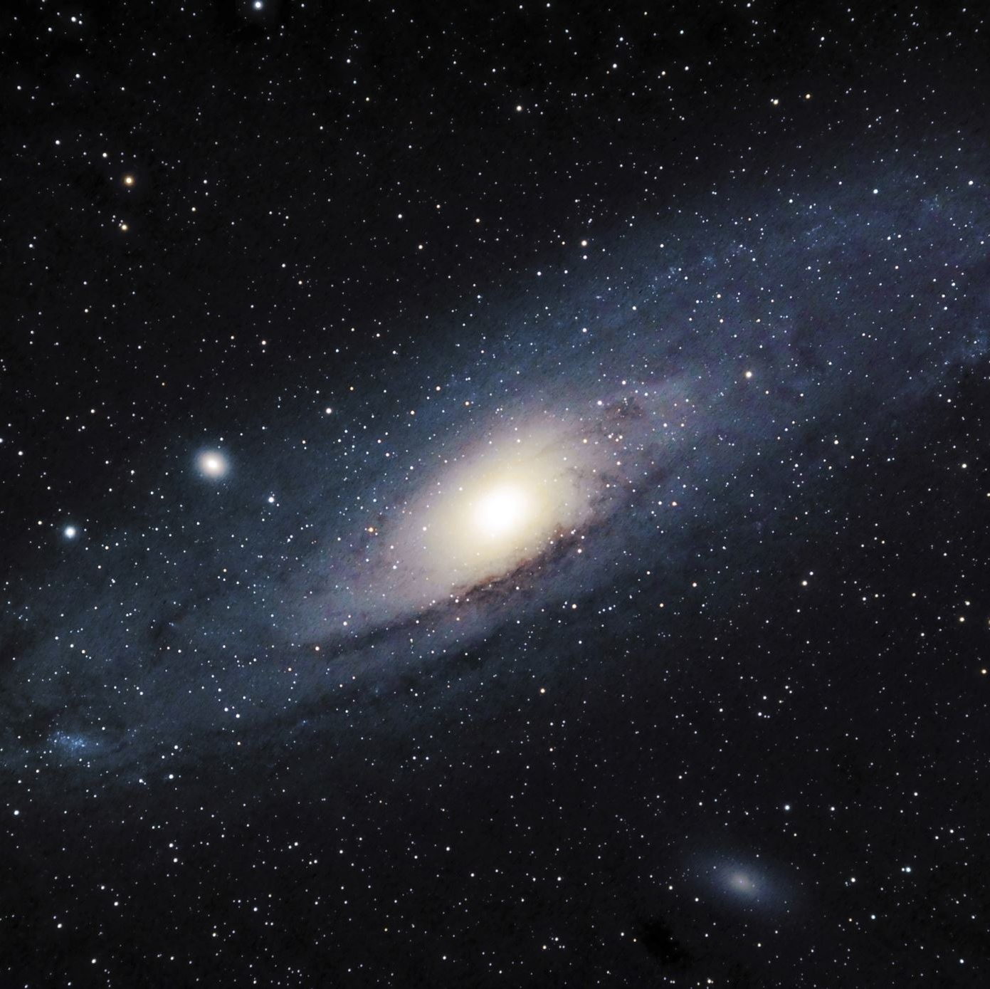
THE CASSINI GROUP
The Cassini Group will be open to our young members aged between 12 and 16 years old.
Our young members will be introduced to the basics of astrophysics and through actively observing our sun, planets, stars, galaxies, and deep sky objects learn about the universe.

Slide 16

ANY QUESTIONS?

Slide 17

HOW CAN YOU GET INVOLVED IN PMAA?
Become a telescope operator
Work at the front desk
Meet and greet guests on the Open Night, during school holidays
Become a presenter
Help organize a special event.
Make your specialist skill sets available to the Association as and when required
Should you decide to volunteer in one of the above areas, training will be provided
Contact: administration@pmobservatory.org.au

Slide 18

Volunteer
Role – Specific Information and Responsibilities.

