Slide 1

Leave Estimator & Forecasting Leave
- eduPay
Leonie Gray
Schools People Services
People and Workplace Relations (Schools)

Slide 2
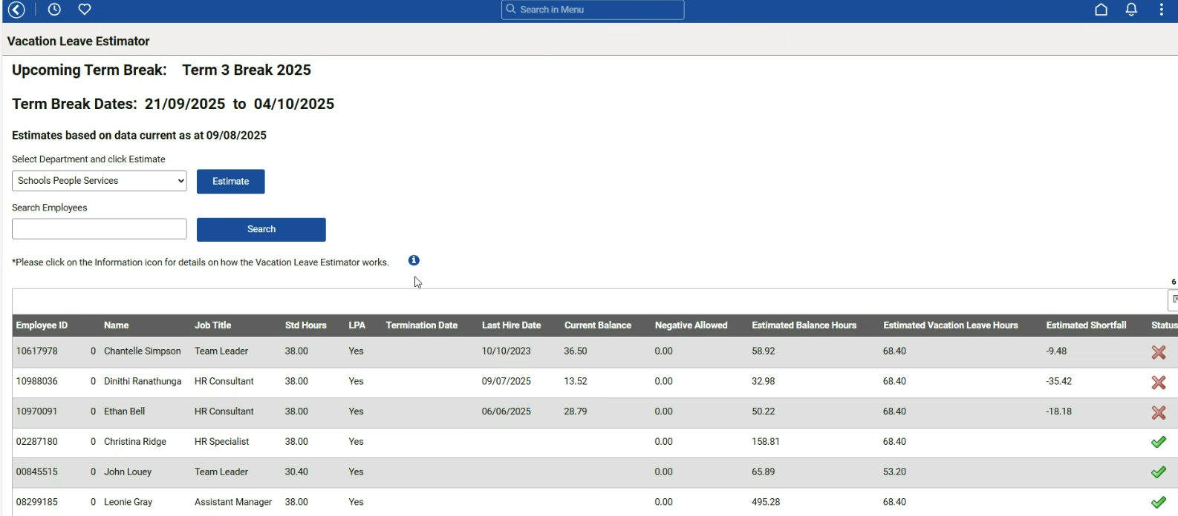
Vacation Leave Estimator
In a school location you will only be able to see your own employees.
Default is the complete Education Support (ES) employee list; including those on leave. You can search for an individual employee.
Notes:
Vacation Leave Estimator (VLE) is a great starting point for reviewing education support employees projected leave accruals for the upcoming vacation period
The VLE ‘assumes’ that every ES employee will be accessing leave for the entire vacation period – therefore it does not account for those employees who are in receipt of LPA.
This report indicates that the first 3 listed employees are not likely to have sufficient entitlement for the entire period
However it correctly indicates that no employee in this example are able to have a negative at any point in time, which is another spot check that LPA is recorded for these employees
All 6 employees are in receipt of 228 hours Leave Purchase Allowance (LPA)
The data in this estimator is based on the leave records in eduPay as at the end of the most recent pay period that has been finalised (eg PAY2025-03) on this occasion
Therefore, if you were wanting to determine as at today whether an employee would have enough leave credits available for the Term 4 term break that commences on 22nd December 2025, this is not the correct place for you to go to.

Slide 3
Using the Vacation Leave Estimator– Points to Consider
Valid for immediately upcoming term break
Accurate at time of creation
eduPay cannot be aware of leave not yet recorded
Cannot base decisions regarding eligibility for other pay term breaks
Vacation Leave Estimator – is exactly that – an estimate!
Notes:
As stated previously the Vacation leave Estimator is static as at a point in time, and any leave entries recorded since that date have not yet been considered.
The data can only be relied upon for the closest term break – the dates are included in the heading section of the page – in this example 21st September to 4th October 2025
The estimate is accurate as it the records in eduPay as at the date stated in the heading – in this example 9 August 2025
The estimator cannot consider nor included leave entries not yet recorded in eduPay
The estimator cannot consider nor included time fraction changes not yet recorded in eduPay
Cannot be used to estimate an eligibility for future term breaks beyond the one the estimator relates to, however it is a great starting point

Slide 4
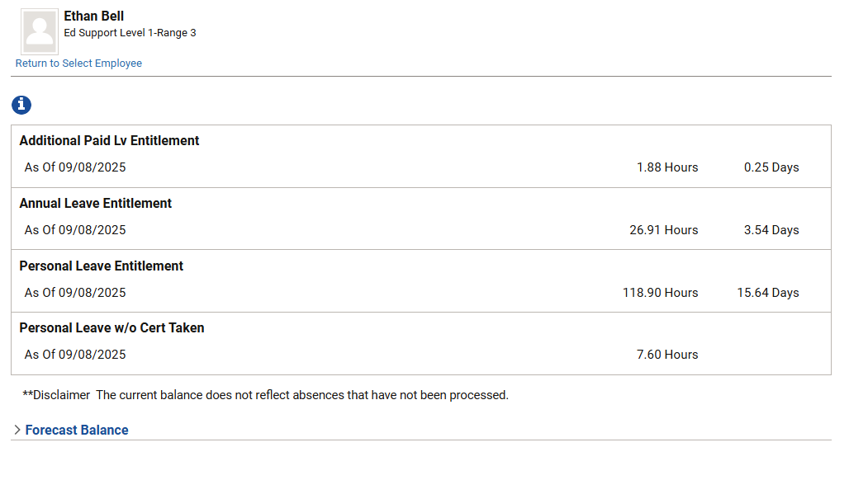



Employee Existing Leave Balances
Notes:
If we want to estimate what an employees leave balances will be for the term 4 vacation period
Go to their current leave balances – as displayed in this slide
Expand the arrow beside Forecast Balance

Slide 5
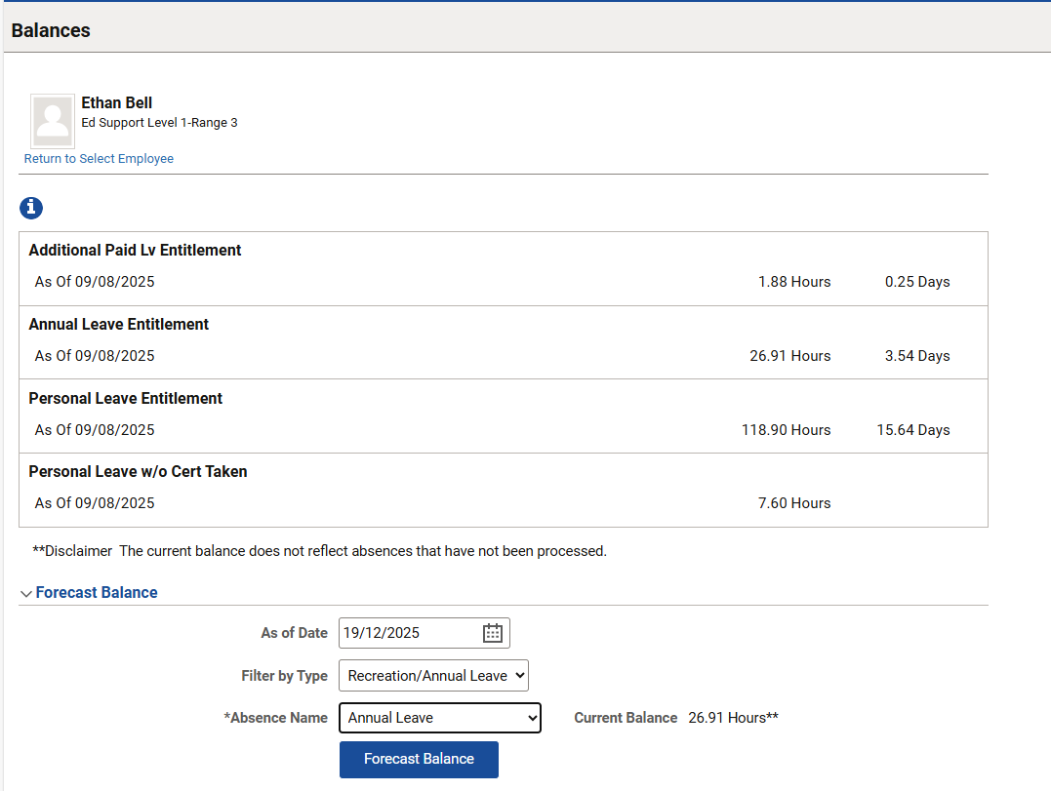


Forecasting Annual Leave
Notes:
Select the date that you want the balance to be calculated for – in this example the last day of Term 4, 2025
Select the type of leave – Recreation/Annual Leave
Select the absence name – for all employees Annual Leave
Click on forecast balance

Slide 6
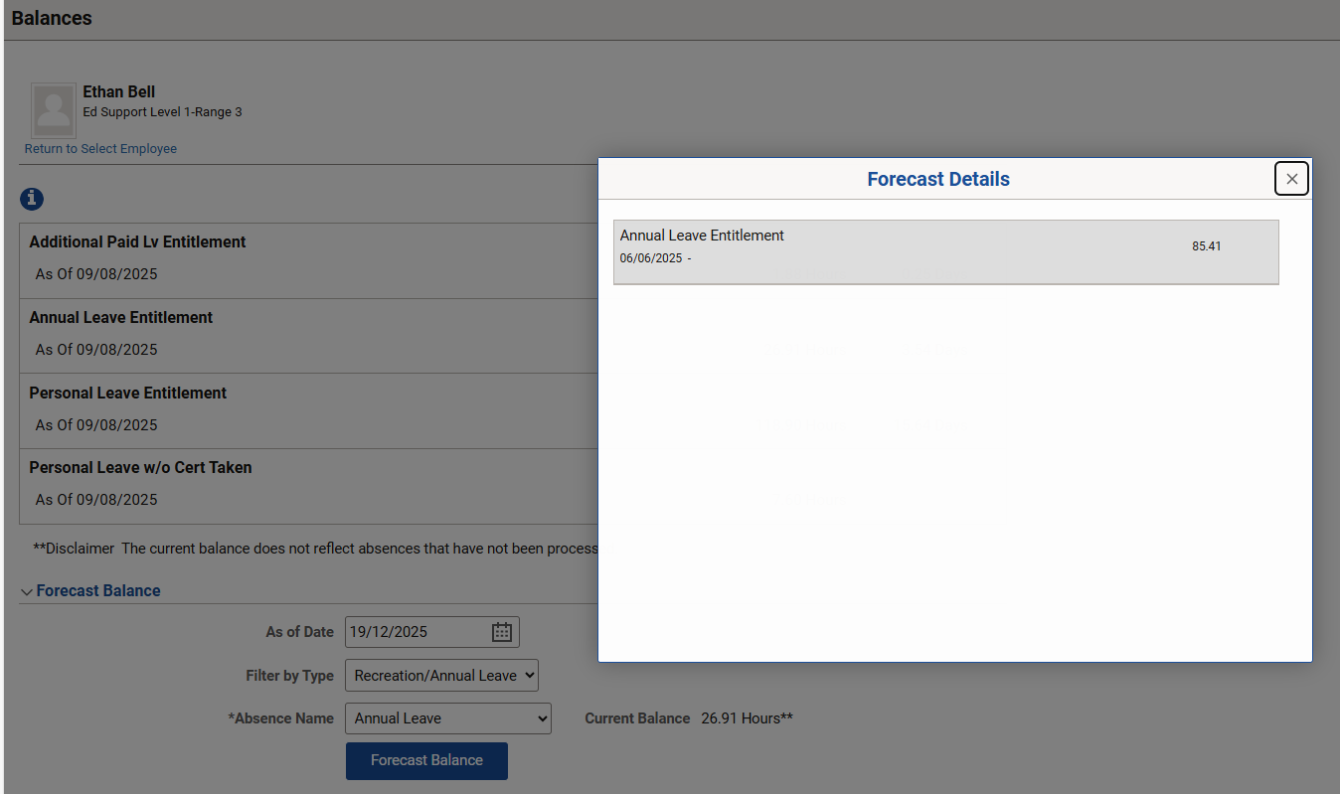

Forecasting Annual Leave part 2
Notes:
This employee’s current balance is 26.91 hours of annual leave as at 19 December 2025 the expected balance of annual leave would be 85.41 hours
This forecast will only take into consideration any annual leave entries that are already recorded and approved in eduPay

Slide 7
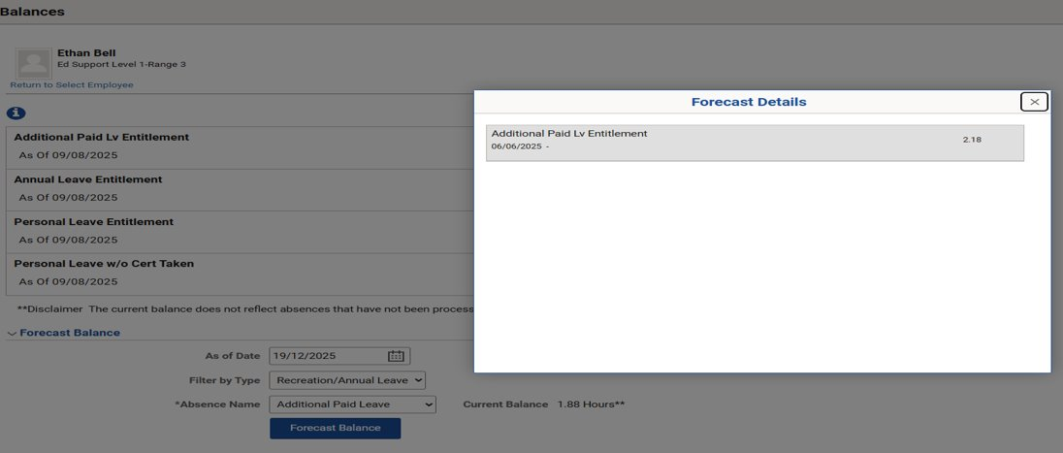




Forecasting Additional Paid Leave
Notes:
If the employee is not in receipt of 228 hours of Leve Purchase Allowance (so not on the 20 day leave model) you also need to forecast the balance of Additional Paid Leave as at the same date
Therefore select the Absence Name Additional Paid Leave and click on Forecast Balance
The current balance is 1.88 hours and their projected balance is 2.18 hours
Therefore to confirm the total leave credits that this employee would have as at the last day of term 4, 2025 then add both forecasted balances together,
If you know, as an example that this employee is going to take a number of hours this vacation period (as an example 38) then you would deduct 38 hours from the total you just confirmed before – as it is not yet recorded on eduPay

Slide 8

Questions?
https://eduvic.sharepoint.com/sites/eduPay/SitePages/HR-admin-guides.aspx
https://www2.education.vic.gov.au/pal/calculators-and-ready-reckoners/overview
is provided under a Creative Commons Attribution 4.0 International licence. You are free to re-use the work under that licence, on the condition that you credit the State of Victoria (Department of Education), indicate if changes were made and comply with the other licence terms, see: https://creativecommons.org/licenses/by/4.0/
The licence does not apply to:
• any images, photographs, trademarks or branding, including the Victorian Government logo and the DE logo; and
• content supplied by third parties.
Copyright queries may be directed to copyright@education.vic.gov.au
© State of Victoria (Department of Education) 2024

