Slide 1
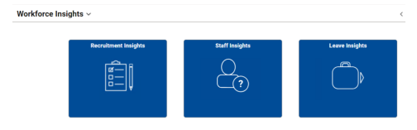


eduPay Data Insights
Navigation deets…
Data insights is the eduPay data visualisation tool for user-friendly analysis to create interactive dashboards, charts and graphs.
With it’s real time data and intuitive search, Data Insights can be explored using inbuilt filter capabilities to fine tune reporting requirements to identify trends, patterns and anomalies to inform future planning.
Head to Workforce Insights via a range of nav options to get started now…
Manager Homepage > Workforce Insights
HR Admin Homepage > Workforce Insights
Workforce Insights Homepage
Reducing your administrative burden the eduPay way
Detailed Support Guide
Notes:
Intro Data Insights – read all deets off this page as the launch page into the following slides

Slide 2





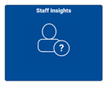




Data Insights
Dashboard visualisations via Workforce Insights
(Add nav)
How to plan ahead using Data Insights information…
Designed as an alternative to the classic search enabling you to search the applicant pool visually
…see who is available in the near future and what roles they will be able to fill at my school
Applicant Pool
Prins, BMs & SRU have visibility of job vacancies and can report on the effectiveness of different initiatives that have been applied
1
…see the effectiveness of different Opening types helps me to determine an approach for future vacancies/
Recruitment Insights
2
Used to monitor the status of your team and ensure these requirements are being met for their roles
…see which cards have an expiry date coming up within the next 8 weeks allows me to start having conversations with staff members with plenty of time.
3
WWCC & VIT Insights
Access upcoming termination dates, hire dates and contract end dates to make better informed decisions and fine tune workforce planning
…see upcoming terminations, probations and hires for the next 60 days allows me to plan for the near future.
4
Staff Insights
5
Understand the types and names of all the absences for any given time period as well as how many hours of leave, trends and transactional data
…see how many hours of leave were taken for the current and prior year, by the type of leave and job code allows me to plan for next year.
Absence Event - Leave
6
Visibility of past events, effort & costs to support these events to plan for future events, hours accrued & balances for individuals. Cost of acquittals, est. cost of balances for both employee & school.
Time in Lieu
…see past costs and hours accrued / acquitted allows you to plan ahead for the upcoming year.
Reducing your administrative burden the eduPay way
Detailed Support Guide
Notes:
Talk through the three tiles that are available via Workforce Insights. List out loud the six available insights available to schools with the item in bold in the descripter only and then onto the plan ahead item so…
Eg Applicant Pool – enables you to search the applicant pool visually to see who is available in the near future and what roles they will be able to fill in your school – do the same for each of the six streams

Slide 3
Data Insights
New visualisations coming soon
Payroll
Leave v2
New Data Insights – Payroll includes…
Better understanding of your school’s payroll
Reporting on Arrears/Overpayments
Reporting on General Ledgers (GL)
Reporting on Allowances
New Data Insights – Leave v2 includes…
Better visibility of maternity/long service leave
Better visibility of pushed back leave
Easier navigation
Reporting on employee balances (low/no balances)
Reducing your administrative burden the eduPay way
Detailed Support Guide
Notes:
Plug upcoming new insight which will be available in September – read benefits out for each item

Slide 4
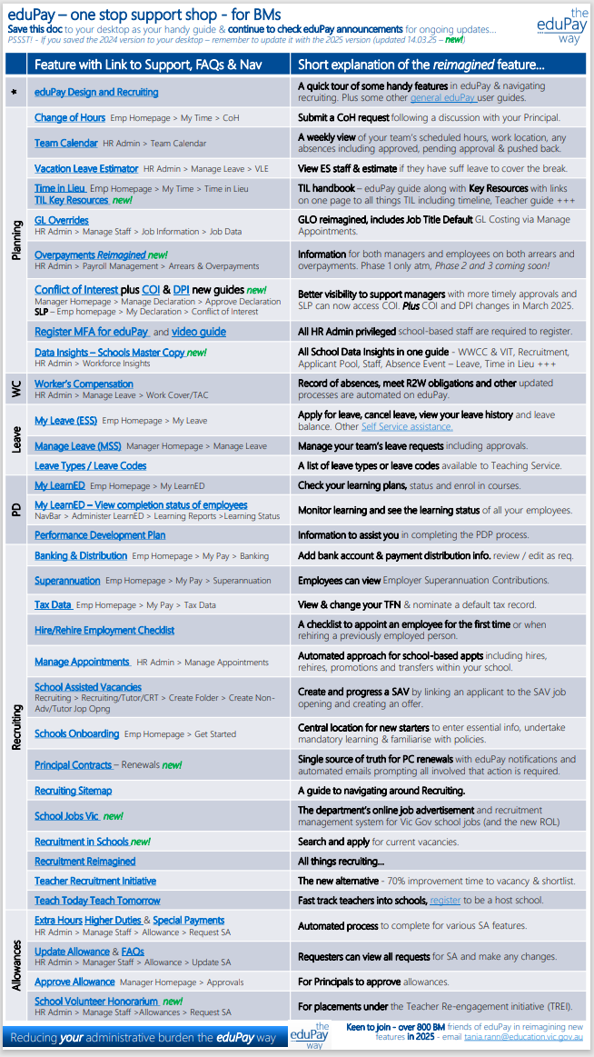


#BMfriendsofeduPay
Volunteer, one stop shop & save the dates!
T3 - Q&A with eduPay experts
Invites will be sent to your Network Leaders to cascade…
Monday 8 September : 11.00 – 12 noon
Tuesday 9 September : 1.00 – 2.00 pm
Thursday 11 September : 10.30 – 11.30 am
Copy and paste the link in your calendar at the scheduled time…
Email Tania Rann
To register your interest / provide feedback & be a part of our business working groups ☺
All welcome!
Tania.rann@education.vic.gov.au
Reducing your administrative burden the eduPay way
Detailed Support Guide
Notes:
Talk through the opportunities to get involved in working groups where BMs codesign eduPay with the eduPay project team, share the one.stop.shop details which has had over 5,000 views and has everything BMs need in the one spot and plug the upcoming Q&A sessions with the eduPay experts – real time answers, with live experts

