Slide 1
Business Managers Victoria – Mentor Program 2025
School Finance Liaison Officers and Finance Support
Presenter – Matthew Smitten

Slide 2
Welcome
Acknowledgement of Country
We acknowledge the Traditional Owners of the land on which we meet and pay our respects to their Elders past and present.
We also acknowledge other Elders and First Nations people who are here today.

Slide 3
Role of School Finance Liaison Officers (SFLO)
The School Finance Liaison Officer team all support schools statewide.
The SFLO team provide support and guidance for new principals, business managers and finance committees, on financial management, such as:
    Assistance with cash budgets and reading reports
    Repayable cash flow assistance
    Internal controls and compliance with financial policy, processes and best practices
    School Council/Finance Committee
    Finance Matters Training– Budgets, Financial Reporting and Financial Management.
SFLO’s Identify problems and refer schools to appropriate support, such as:
    CASES21 Finance Business Process Guide
    refresher training
    Service Desk
    They do not complete financial transactions or prepare reports on behalf of the school

Slide 4
Role of Strategic Finance Management Advisors (SFMA)
The Strategic Finance Management Advisors are region based and provide:
Support for principals in technical leadership.
    Alignment of the Student Resource Package (SRP) with the school’s strategic plan.
    Reorganisation assistance for clusters of schools.
    Workforce planning and staff management advice.
Assists schools to develop workforce budget plans
    Where significant enrolment volatility impacts directly on their ability to balance their school budget within their confirmed SRP.
Supports principals, in particular, new appointees
    in their role as a principal and leader in a school community .
    in understanding and implementing effective technical leadership practices.

Slide 5
Contact Details
    SFLO - school.finance.liaison.officer@education.vic.gov.au
    SFMA - schools.finance.support@education.vic.gov.au
Service Desk
    For knowledge articles
    Telephone support and logging calls for error resolution
    DE Services Portal or phone the Department’s Service Desk on 1800 641 943

Slide 6
Professional Development
Professional Development is facilitated through the Victorian Academy of Teaching and Leadership
Finance Matters Sessions
    Budget Development
    Financial Reporting
    Student Resource Package (SRP) & Workforce Budgeting
    Taxation & Insurance
    Assets in Schools
  SFLO Presentations
    Budget Review – Confirmed SRP Session (Term 2)
    New & Aspiring Business Managers
    Leave Reimbursement – Awareness in Schools
    Finance Chatters
    DE Budget Spreadsheet
    Budget Masterclass (invite only) – For new Business Managers who commenced any time from the beginning of Term 4 2024
    Enrolment for sessions via the Victorian Academy of Teaching and Learning at Finance Matters

Slide 7
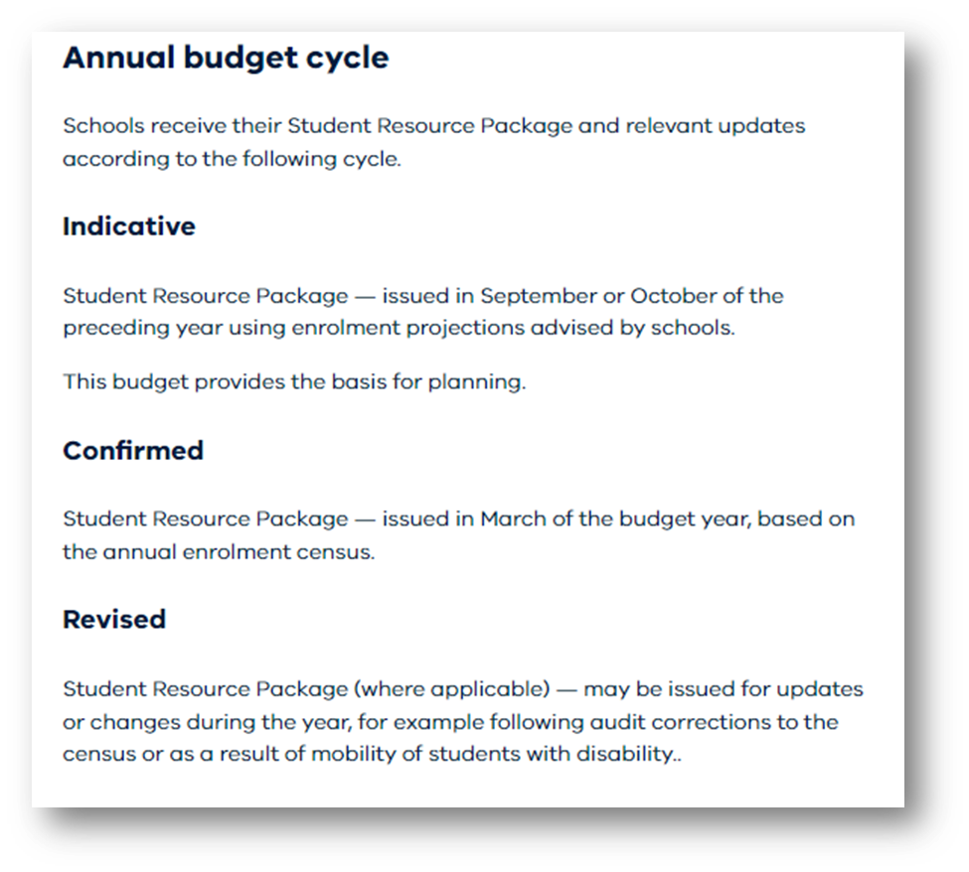
Budget Cycle

Slide 8
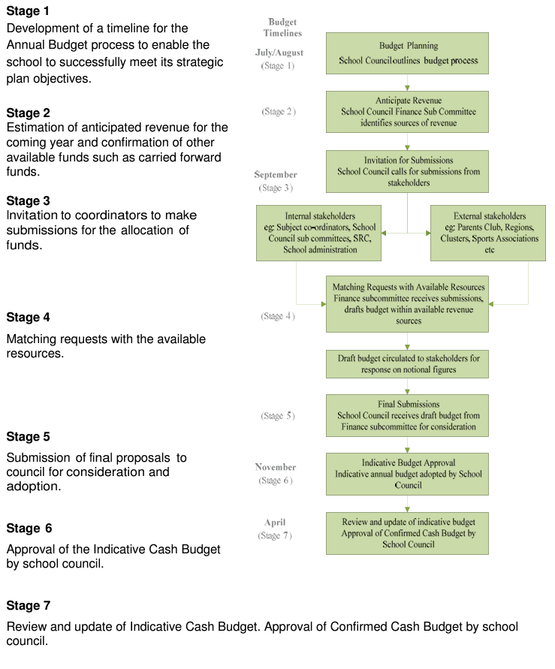
2026 Budget Preparation
Last week of term 3 - SRP Indicative budget released
Term 3 through term 4 - Development of the Indicative Cash Budget for the future year
Utilise the Departments Annual master budget spreadsheet to develop the budget
Cash budget spreadsheet user guide
Use budget development resources available at Financial Management for Schools: Resources

Slide 9
Budget Timeline and Approvals
Term 4
Initiator: SRP Indicative Budget Release (last week of term 3)
Action: Development of the Indicative Cash Budget for the future year
School Council to approve the Indicative Cash Budget prior to the end of term 4
Term 1
Initiator: End of Year - December 20XX
Action: Update the Indicative Cash Budget spreadsheet with CASES21 EOY data
Financial Commitments/Final Bank Balances/Unallocated CSEF receipts & families in credit/School Operating Reserve, etc
School Council to approve the Revised Indicative Cash Budget at the first school council meeting of the year
Term 2
Initiator: SRP Confirmed Budget Release - Based on Feb Enrolment Census (last week of term 1)
Action: Review of the Cash Budget Spreadsheet - update with confirmed SRP cash funding
School Council to approve the Confirmed Cash Budget at the first school council meeting of term 2
Term 3/4
Initiator: SRP Revised Budget Release
Action: Review of the Cash Budget Spreadsheet - update with revised SRP cash funding
School Council to approve the Revised Cash Budget at the first school council meeting of term
School Council Minutes: Guide to School Council and Finance Motions
When the Cash Budget is updated with changes it must be presented to school council for approval prior to entry on CASES21

Slide 10
Hot Topics
Revised SRP Budget released last week of term 2:
    Update cash budget spreadsheet and take to school council in term 3 for approval (Update on CASES21 after approval)
Reconciling CASES21 Operating Statement:
    double check your Operating Statement to ensure General Ledger codes match those in your revised cash budget spreadsheet
Koorie Cash Funding:
    early years program (for Foundation to Grade 3 students) released as an offline payment in week 9 term 2
    extended program (for grades 4 to 6 students), included in the Revised SRP Budget
Literacy Transition Funding:
    eligible schools received funding released as an offline payment in week 9 term
Cleaning Funding:
    semester 2 funding provided as an offline payment

Slide 11
Hot Topics
Tutor Learning Initiative
    funding ceasing at the end of 2025. What is the plan for staff employed in these positions?
Agreed Upon Procedure (AUP) and Key Financial Management Control (KFMC) Audits:
    Take time to familiarise yourself with the Finance Manual, Chart of Accounts and other resources available at Financial Management for Schools: Resources, to ensure you are following correct policy and process.
Parent Payments
    need to be approved by school council – generally no later than early term 4
    to be made available to families 6 weeks before the end of term 4
Camp and Excursion and Fundraising Reconciliations
    ensure they up to date
    obtain permission from school council to write off outstanding charges for camps and excursion

Slide 12
Hot Topics
CSEF
    increasing to $400 in 2026
  Balance Sheet:
    review aged balances and log CASES21 if support required (Asset Clearing Account, Building & Land Clearing Account, Pre-Paid Expenses, Petty Cash, Revenue in Advance, Deposits Held, Leave, Proceeds Asset Sales-Clearing)
  Bank Reconciliations
    review aged transactions for Outstanding Deposits, Un-presented Cheques (Payments) and any differences. (Log CASES21 if support required)
End of Year Finance Rollover:
    attend training offered by CASES21 Training Team
    clean up data prior to end of term 4, to ensure a smooth process when completing end of year rollover (Log CASES21 if support required)
    seek permission from school council to write off any outstanding family charges at the end of the year (generally minuted at last school council meeting of the year

Slide 13
Questions
Thankyou

