Slide 1







Curtin Geoscientists and Engineers Club: 2024 AGM
Geoscientists and Engineers
Curtin University
curtin.geosciences@gmail.com
Notes:
Curtin University Geoscientists & Engineers

Slide 2
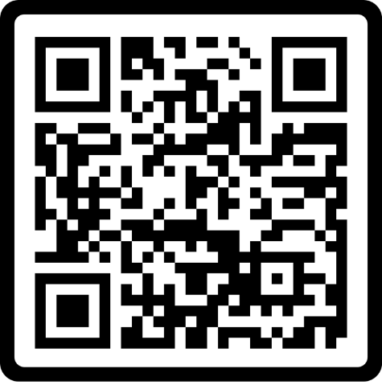


https://guild.curtin.edu.au/club/curtin-gec/

Slide 3

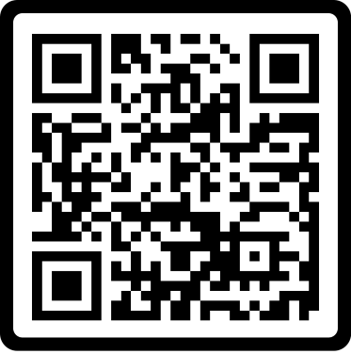

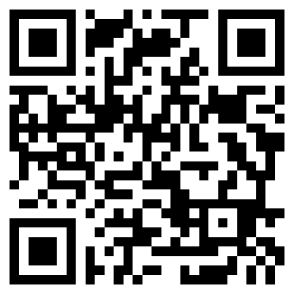

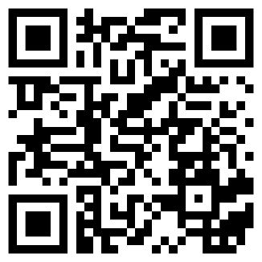

Contact us
Geoscientists and Engineers
Curtin University
curtin.geosciences@gmail.com

Slide 4

CGEC Objectives
Geoscientists and Engineers
Curtin University
Providing a professional environment for students in geosciences backgrounds (Geophysics, Geology, Petroleum Engineering, Energy, Mining, etc.).
Our club's main objectives are to create a professional space for students with geoscience backgrounds to foster their professional skills, development, networking and engagement with professional societies and the industry. To interact with local and international professional societies such as:
ASEG: Australian Society of Exploration Geophysicists
SEG: Society of Exploration Geophysicists
EAGE: European Association of Geoscientists and Engineers
Membership is free for all.
Affiliations
ASEG
SEG
EAGE

Slide 5
Benefits
Geoscientists and Engineers
Curtin University
Exposure
Networking
Event discounts
Free or discounted student memberships
Travel support
Access to publications
Access to grants and scholarships
Access to recognition programs
Access to mentoring programs

Slide 6


Policy
Geoscientists and Engineers
Curtin University
Guild's Default Club Constitution
Standard Guild charter
Default safe spaces agreement

Slide 7
2024 Reports
Geoscientists and Engineers
Curtin University
President
Secretary
Treasurer

Slide 8
President Report: Successes & Challenges
Geoscientists and Engineers
Curtin University
Successes
Reestablished Guild student club
Reestablished EAGE student chapter
Reestablished SEG student chapter
Established ASEG collaboration
Challenges
Committee member nominations
Access to funding
Time constraints
Recommendations
Add nonmandatory committee roles
Envolve more BS and MS students

Slide 9

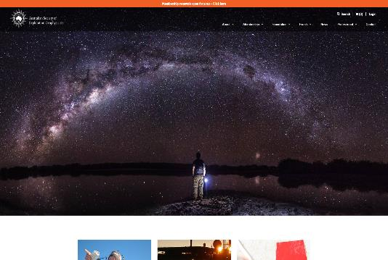
www.aseg.org.au
A non-profit company founded in 1970
A professional society of earth scientists specialising in the practical application of the principles of physics and mathematics to solve problems in a broad range of geological situations.
Student membership fee: free
Benefits:
  Free access to publications
  Professional & Networking Development opportunities
  Huge range of online content
  Students
    Free membership
    Support of student research projects through the ASEG Research Foundation
    Travel scholarships and funding assistance available

Slide 10
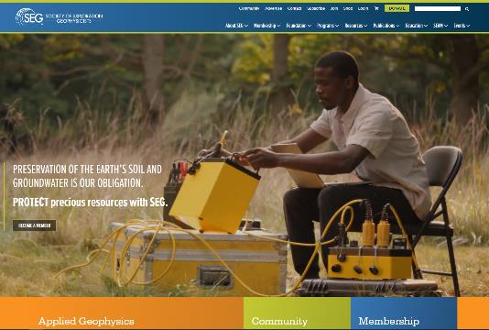
www.seg.org
Founded in 1930
SEG provides information, tools, and
resources vital to:
  Advancing the science of exploration geophysics
  Fostering common scientific interests
  Supporting humanitarian efforts
  Accelerating geophysical innovation
Student membership fee: USD26
Benefits:
  Online access to The Leading Edge Digital Edition and access to the SEG Library
  Minimal admission fee to IMAGE (formerly SEG International Exposition and Annual Meeting)
  SEG scholarship opportunities
  Student discounts on continuing education courses, workshops and on books purchased in the SEG Shop
  Student Chapters
  Upon graduation, Student Members are eligible for FREE Associate Membership dues for the first year following graduation
  And most of all, through association with fellow SEG Members, students enjoy the benefit of developing professional contact and industry ties, increasing opportunities in networking, and guidance in career planning/development

Slide 11
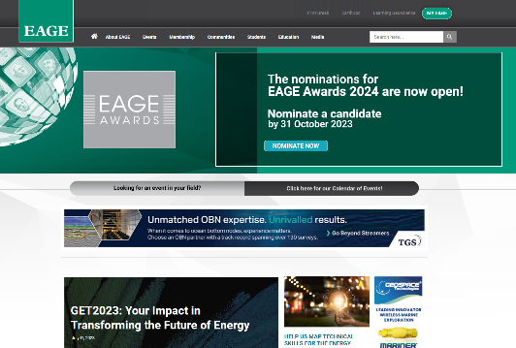
www.eage.org
Founded in 1951
Association objectives: to promote the development and application of geosciences and related engineering subjects, to promote innovation and technical progress and to foster the communication, fellowship and cooperation between those working in, studying or otherwise being interested in these fields.
Student membership fee: €25
Benefits:
  Event discounts
  Access to publications & library
  Continuous education
  Financial support
  Recognition programme
  Mentoring programme

Slide 12
President Report: Activities
Geoscientists and Engineers
Curtin University
Technical Events:
Workshops
Technical talks
Technical webinars
Professional development
Affiliate student memberships
Social Events
Outreach
Field trips
Networking events

Slide 13
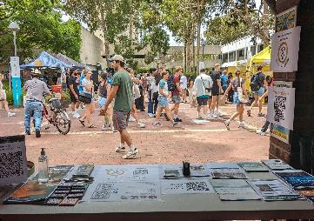

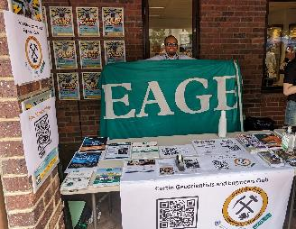

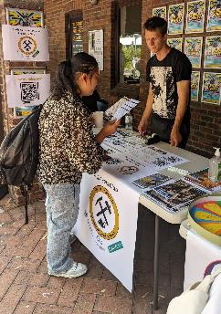
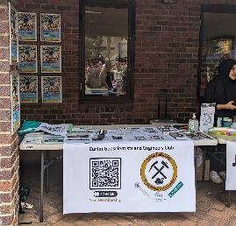
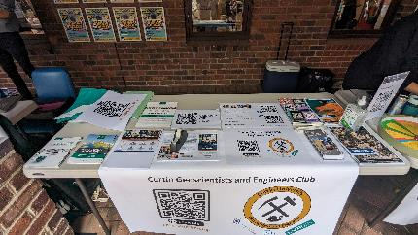


21 Feb 2024

Slide 14
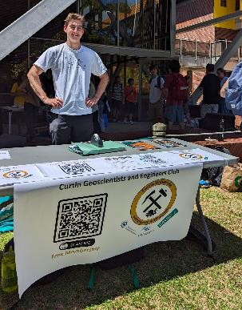

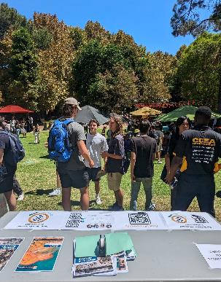
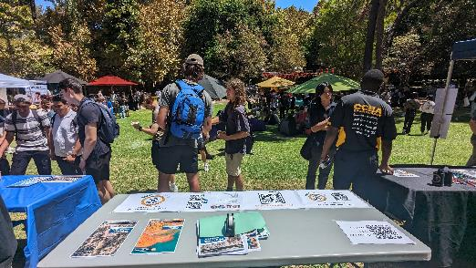
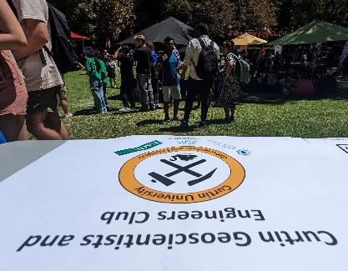

Science and Engineering First Year Expo
22 Feb 2024

Slide 15
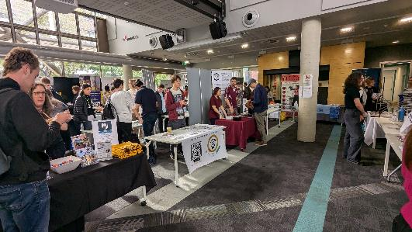
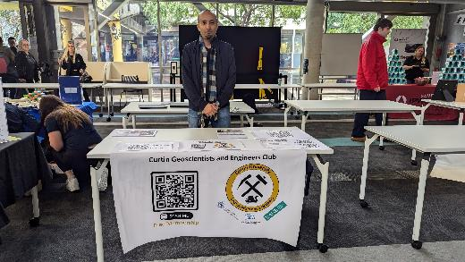
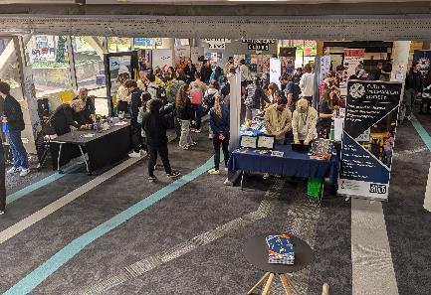

Science and Engineering First Year Expo
18 July 2024

Slide 16
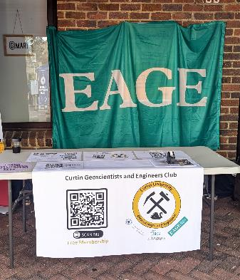
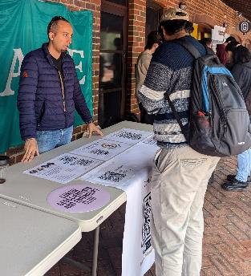
24 July 2024

Slide 17
Secretary Report: Membership
Geoscientists and Engineers
Curtin University
2024 Student Membership (68)
2024 Associate Membership (2)

Slide 18
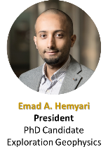
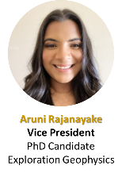
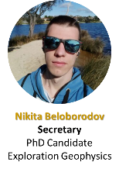
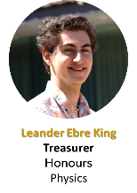
Secretary Report: Structure
Geoscientists and Engineers
Curtin University
President
Emad A. Al-Hemyari
Secretary
Nikita Beloborodov
Vice President
Aruni Rajanayake
Treasurer
Leander Ebre King
Events Coordinator
Communications Coordinator
Faculty Advisor
Prof. Boris Gurevich
Volunteers
Social Media

Slide 19
Secretary Report: Meetings
Geoscientists and Engineers
Curtin University
Committee Meetings & Major Decisions:
Two committee meetings held last year
Designing of signatories for a bank account
Opening a bank account
Recommendations for New Committee:
Invite new treasurer as the current Treasurer is graduating
Maintain the bank account
Club renewal

Slide 20
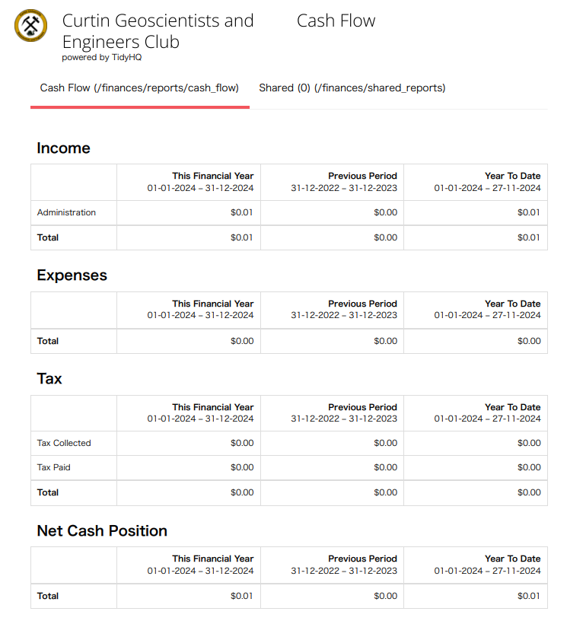
Treasurer Report
Geoscientists and Engineers
Curtin University
No income
No expenses
Bank account was closed without a notice due to inactivity

